Slide 1





















Introduction to deep learning
Angelo Ziletti, PhD
Principal Data Scientist, Bayer AG

Slide 2
Lecture Outline
Part 1.
Introduction to Neural Networks
1
Part 2.
Multi-layer perceptrons (MLPs)
2
Part 3.
Optimization and Regularization in Deep Learning
3
Part 4.
Multi-layer perceptrons in condensed matter physics
4

Slide 3
What is deep learning?
Artificial Intelligence (AI)
Machine Learning (ML)
Representation Learning
Deep Learning (DL)
Extract patterns from data using neural networks
Any technique that enables computers to mimic human behavior
Ability to learn without explicitly being programmed
Learn both representation and predictive model
Symbolic Regression
From Introduction to Deep Learning (http://introtodeeplearning.com/)

Slide 4
Why Deep Learning?
Hand engineering features is time consuming, brittle, and not scalable in practice
Often it is hard to specify rules to accomplish complex tasks:
Why is that a tree or a house?
Even if we can specify rules that works ok, these rules will not be transferable
For each new task, you need to define new rules from scratch
Deep Learning aims to learn the underlying features relevant for the task directly from the data
Through a series of layers, neural networks automatically learn more complex features from the data

Slide 5
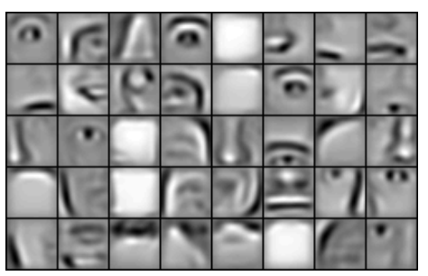
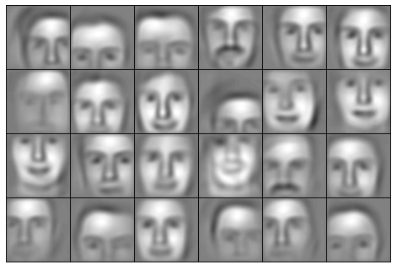
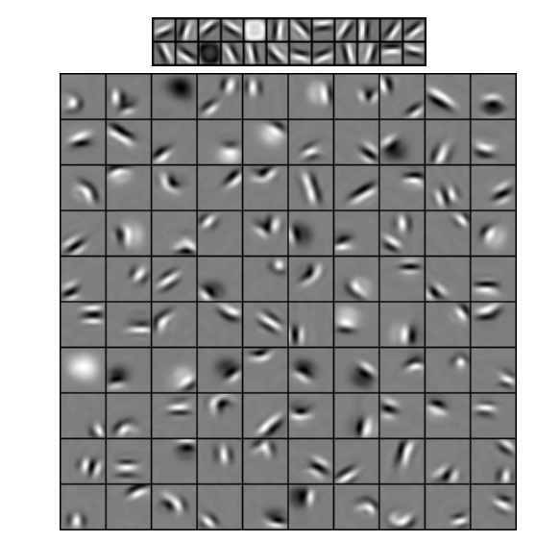
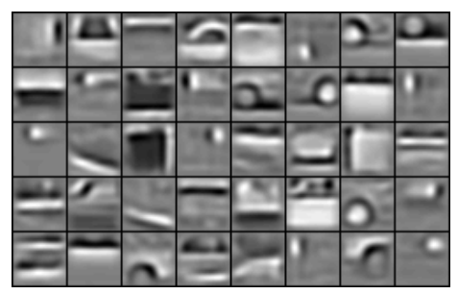
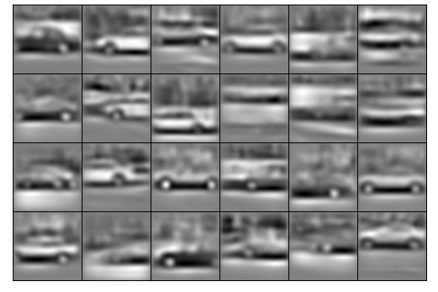
Deep learning is learning the underlying features from data
Mid Level Features
High Level Feature
Low Level Features:
lines and edges
Category: Faces
Category: Faces
Category: Cars
Category: Cars
Figures from Lee at al., ICML 609-616 (2009)

Slide 6
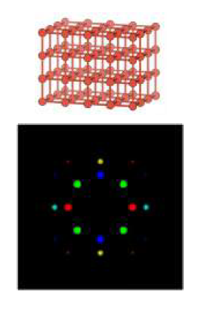
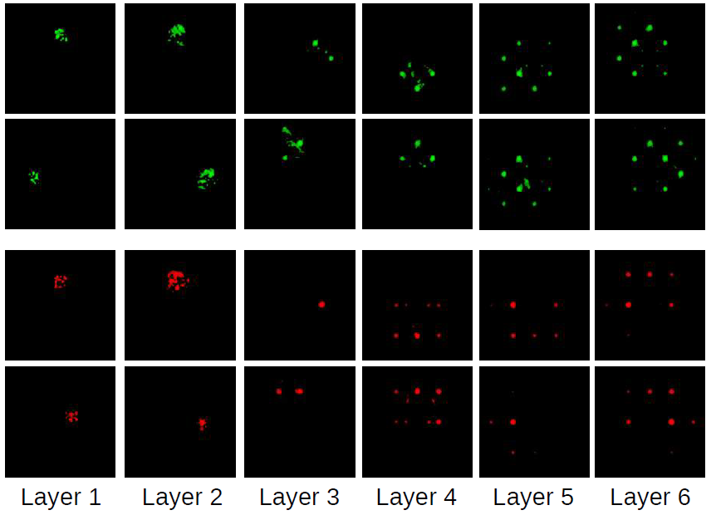
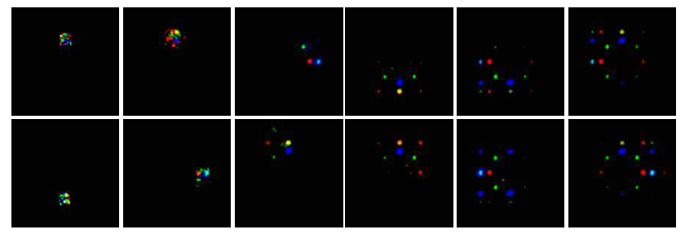
Learning the underlying features from data: materials science example
The network is automatically learning relevant features from data also for a materials science task (with limited data) [1]
Input image
Figures from [1] A. Ziletti et al., Nature Communications, 9, 2775 (2018)

Slide 7
A short selection of deep learning applications
Automatic speech recognition
All major commercial speech recognition systems (e.g., Microsoft Cortana, Xbox, Skype Translator, Amazon Alexa, Google Now, Apple Siri, Baidu and iFlyTek voice search, and a range of Nuance speech products, etc.) are based on deep learning
Image recognition
Deep learning-trained vehicles now interpret 360° camera views for self-driving cars
Natural language processing
Google Translate (GT) uses a large end-to-end long short-term memory network
The deep learning technique BERT is used to improve searches on Google (Oct 2019) [*]
Medical Image Analysis
Competitive results in medical applications such as cancer cell classification, lesion detection, organ segmentation and image enhancement
…
From Wikipedia (https://en.wikipedia.org/wiki/Deep_learning#Commercial_activity)
[*] Understanding searches better than ever before (Google Blog) (https://www.blog.google/products/search/search-language-understanding-bert/)

Slide 8
Classification problems
Examples of classification problems
Does this email belong in the spam folder or the inbox? Or promotions? Or social?
Is this transaction fraudulent? Is this a cybersecurity attack?
Is this a melanoma or not?
And in physics/materials science? Any ideas from you?
Given this chemical composition, is this material (in its lowest energy configuration) going to be a metal or an insulator?
What is the most similar crystal prototype to this material?
Where are the atoms in this scanning transmission electron microscopy (STEM) image located?
Is this spin configuration close to a ferromagnetic transition?

Slide 9
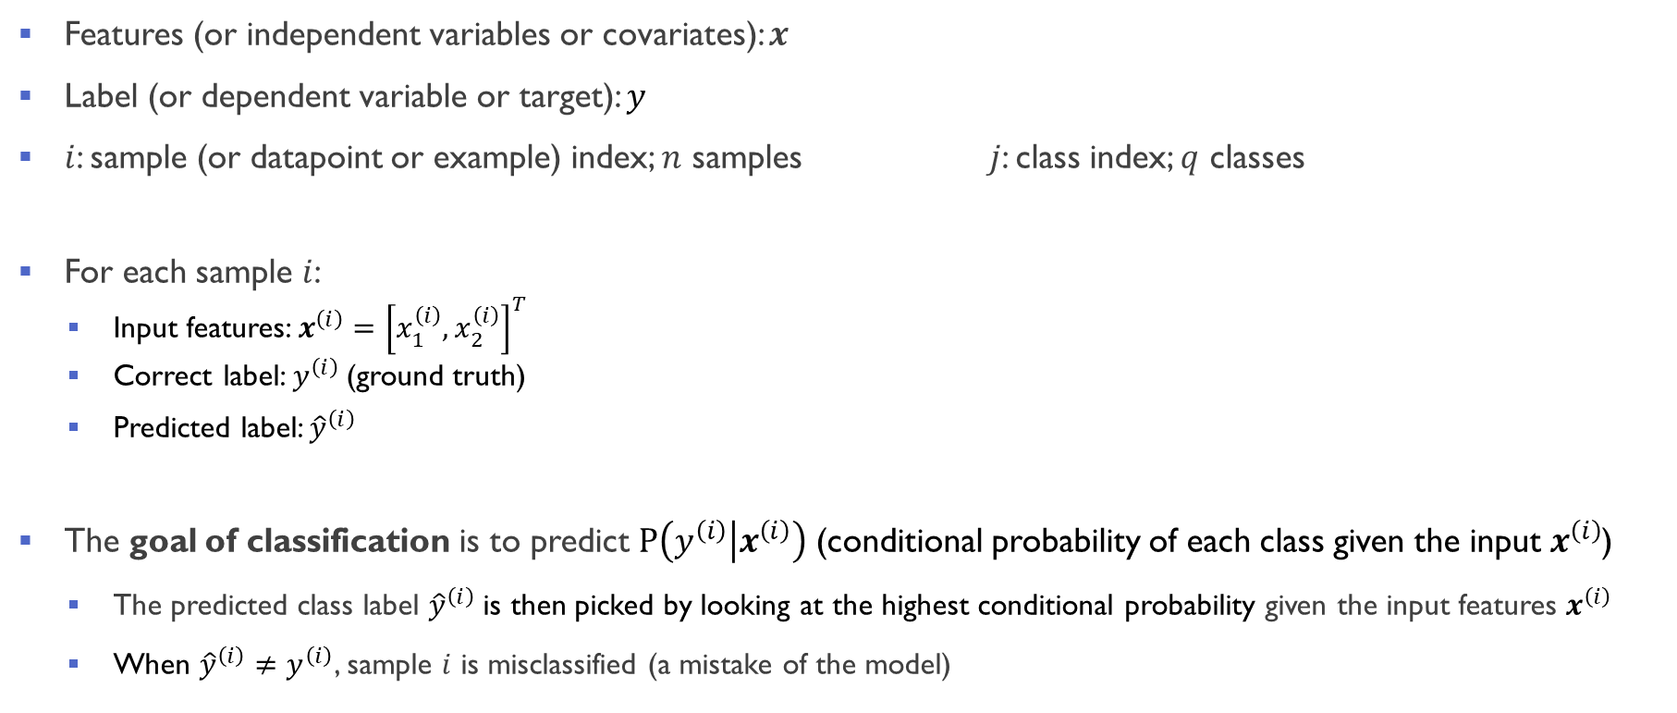
Some terminology
Features (or independent variables or covariates): $x$
Label (or dependent variable or target): $y$
$i$: sample (or datapoint or example) index; $n$ samples $j$: class index; $q$ classes
For each sample $i$:
Input features: $x^{\left(ⅈ\right)}={\left[x_{1}^{\left(i\right)},x_{2}^{\left(i\right)}\right]}^{T}$
Correct label: $y^{\left(ⅈ\right)}$ (ground truth)
Predicted label: ${\hat{y}}^{\left(ⅈ\right)}$
The goal of classification is to predict $P\left(\left.y^{\left(ⅈ\right)}\right|x^{\left(ⅈ\right)}\right)$ (conditional probability of each class given the input $x^{\left(ⅈ\right)}$)
The predicted class label ${\hat{y}}^{\left(ⅈ\right)}$is then picked by looking at the highest conditional probability given the input features $x^{\left(ⅈ\right)}$
When ${\hat{y}}^{\left(ⅈ\right)}≠y^{\left(ⅈ\right)}$, sample $i$ is misclassified (a mistake of the model)
Notes:
Obviously we want our model to make as few mistakes as possible;

Slide 10
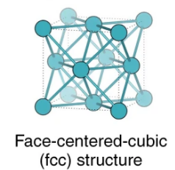
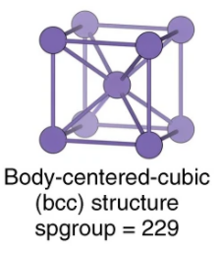
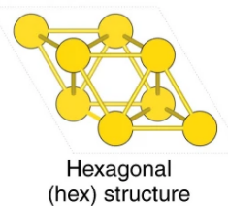
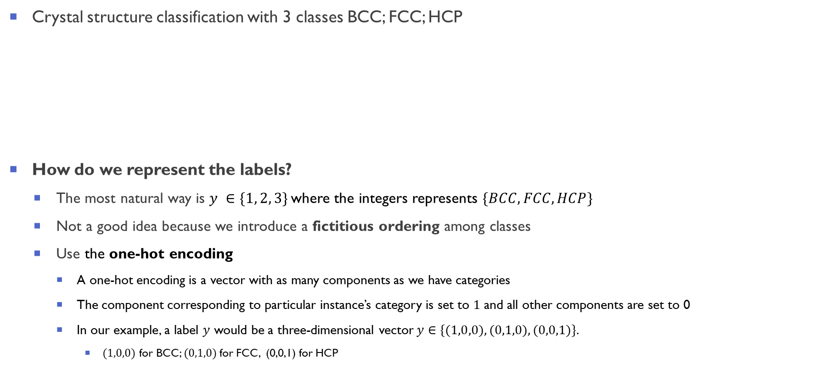
Setting the stage with an example (1/2)
Crystal structure classification with 3 classes BCC; FCC; HCP
How do we represent the labels?
The most natural way is $y ∈\{1, 2, 3\}$where the integers represents $\{BCC, FCC, HCP\}$
Not a good idea because we introduce a fictitious ordering among classes
Use the one-hot encoding
A one-hot encoding is a vector with as many components as we have categories
The component corresponding to particular instance’s category is set to $1$ and all other components are set to 0
In our example, a label $y$ would be a three-dimensional vector $y∈\{(1,0,0),(0,1,0),(0,0,1)\}.$
$(1,0,0)$ for BCC; $(0,1,0)$for FCC, (0,0,1) for HCP

Slide 11
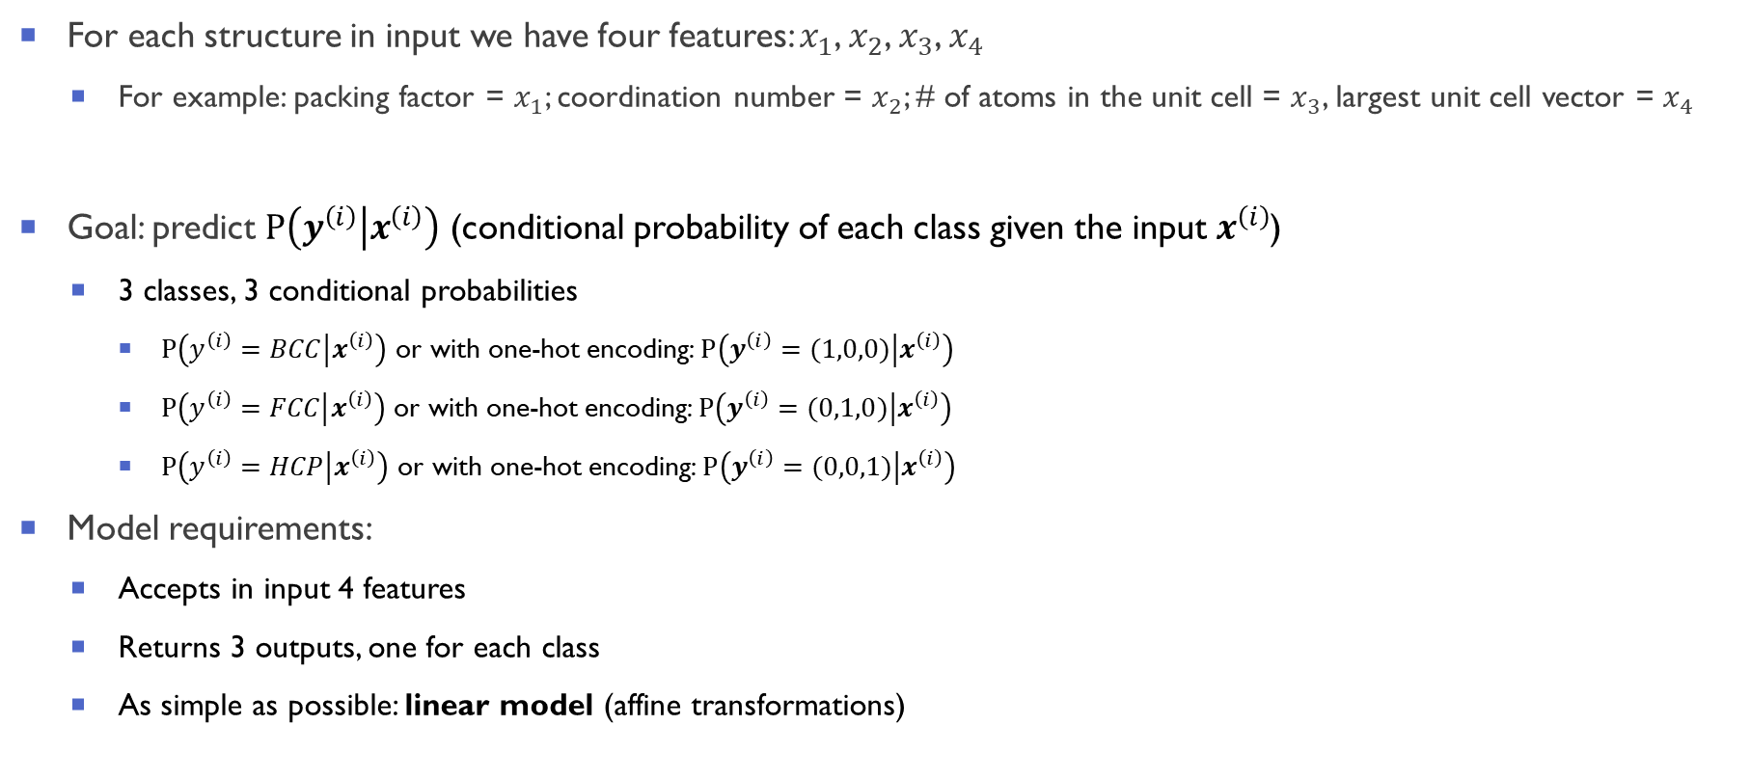
Setting the stage with an example (2/2)
For each structure in input we have four features: $x_{1}$, $x_{2}$, $x_{3}$, $x_{4}$
For example: packing factor = $x_{1}$; coordination number = $x_{2}$; # of atoms in the unit cell = $x_{3}$, largest unit cell vector = $x_{4}$
Goal: predict $P\left(\left.y^{\left(ⅈ\right)}\right|x^{\left(ⅈ\right)}\right)$ (conditional probability of each class given the input $x^{\left(ⅈ\right)}$)
3 classes, 3 conditional probabilities
$P\left(\left.y^{\left(ⅈ\right)}=BCC\right|x^{\left(ⅈ\right)}\right)$ or with one-hot encoding: $P\left(\left.y^{\left(ⅈ\right)}=(1,0,0)\right|x^{\left(ⅈ\right)}\right)$
$P\left(\left.y^{\left(ⅈ\right)}=FCC\right|x^{\left(ⅈ\right)}\right)$ or with one-hot encoding: $P\left(\left.y^{\left(ⅈ\right)}=(0,1,0)\right|x^{\left(ⅈ\right)}\right)$
$P\left(\left.y^{\left(ⅈ\right)}=HCP\right|x^{\left(ⅈ\right)}\right)$ or with one-hot encoding: $P\left(\left.y^{\left(ⅈ\right)}=(0,0,1)\right|x^{\left(ⅈ\right)}\right)$
Model requirements:
Accepts in input 4 features
Returns 3 outputs, one for each class
As simple as possible: linear model (affine transformations)

Slide 12





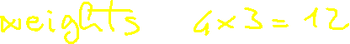



























Slide 13
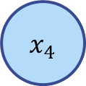
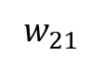
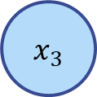
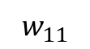
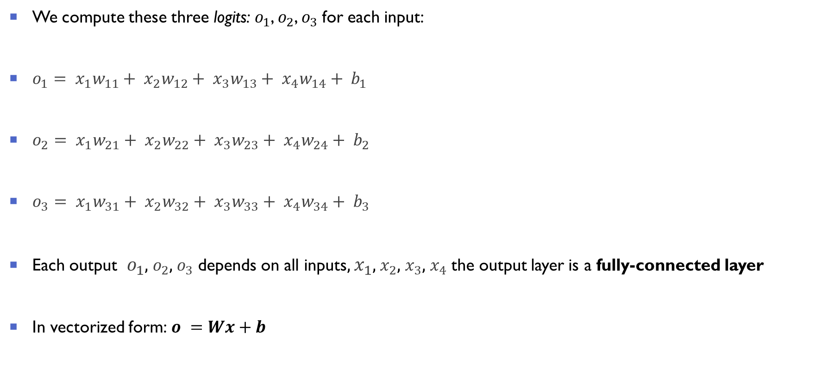

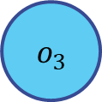
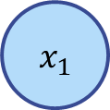

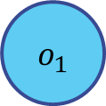
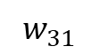
Network architecture
We compute these three logits: $o_{1}$, $o_{2}$, $o_{3}$for each input:
$o_{1}= x_{1}w_{11}+ x_{2}w_{12}+ x_{3}w_{13}+ x_{4}w_{14}+ b_{1}$
$o_{2}= x_{1}w_{21}+ x_{2}w_{22}+ x_{3}w_{23}+ x_{4}w_{24}+ b_{2}$
$o_{3}= x_{1}w_{31}+ x_{2}w_{32}+ x_{3}w_{33}+ x_{4}w_{34}+ b_{3}$
Each output $o_{1}$, $o_{2}$, $o_{3}$ depends on all inputs, $x_{1}$, $x_{2}$, $x_{3}$, $x_{4}$ the output layer is a fully-connected layer
In vectorized form: $o =Wx+b$
$$o_{1}$$
$$o_{2}$$
$$o_{3}$$
Output Layer
$$w_{11}$$
$$w_{21}$$
$$w_{31}$$
$$x_{1}$$
$$x_{2}$$
$$x_{3}$$
$$x_{4}$$
Input Layer

Slide 14
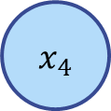
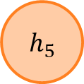
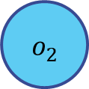
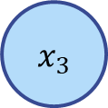
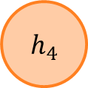
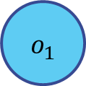
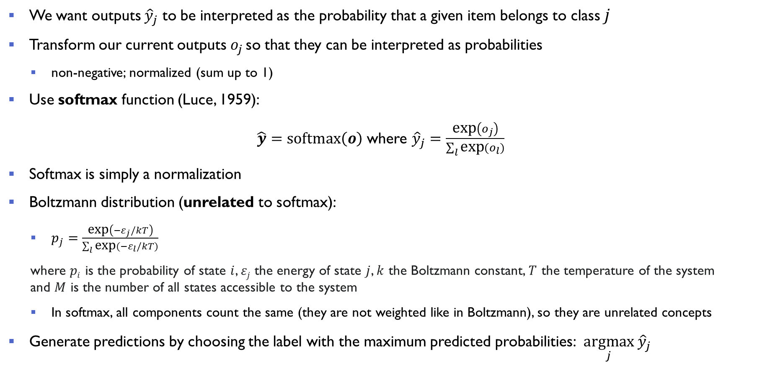
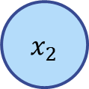
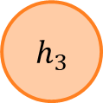

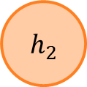

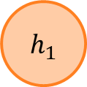
Softmax regression: predicting probabilities and labels
We want outputs ${\hat{y}}_{j}$ to be interpreted as the probability that a given item belongs to class $j$
Transform our current outputs $o_{j}$ so that they can be interpreted as probabilities
non-negative; normalized (sum up to 1)
Use softmax function (Luce, 1959):
$\hat{y}=\text{softmax}\left(o\right)$ where ${\hat{y}}_{j}=\frac{\text{ex}\text{p}\left(o_{j}\right)}{\sum_{l}{\text{exp}{(o_{l})}}}$
Softmax is simply a normalization
Boltzmann distribution (unrelated to softmax):
$p_{j}=$ $\frac{\text{exp}\left(−ε_{j}/kT\right)}{\sum_{l}{\text{exp}{(−ε_{l}/kT)}}}$
where $pi$ is the probability of state $i$, $εj$ the energy of state $j$, $k$ the Boltzmann constant, $T$ the temperature of the system and $M$ is the number of all states accessible to the system
In softmax, all components count the same (they are not weighted like in Boltzmann), so they are unrelated concepts
Generate predictions by choosing the label with the maximum predicted probabilities: $\underset{j}{argmax}{ \hat{y}}_{j}$
$$o_{1}$$
$$o_{2}$$
$$o_{3}$$
X
$$h_{1}$$
$$h_{2}$$
$$h_{3}$$
$$h_{4}$$
$$h_{5}$$
X
$$x_{1}$$
$$x_{2}$$
$$x_{3}$$
$$x_{4}$$

Slide 15


Linear is not enough
This model maps inputs directly to outputs via a single affine transformation (followed by softmax)
This is sufficient only if the inputs are related to the outputs via an affine transformation
Linearity in affine transformations is a very strong assumption and rarely true in practice
For example, linearity implies monotonicity: any increase in our feature must either always cause an increase in model’s output (if the corresponding weight is positive), or always cause a decrease in our model’s output (if the corresponding weight is negative
Example 1: is it a door or a window?
Input: pixel values
output: door or window
Example 2: how does the band gap changes if I move by 0.02 Å atom #12?
Input: atomic positions
Output: bandgap
Inputs are linked to outputs in complex, non-linear ways which often are not known in advance or too difficult to compute (e.g. solving the Schrödinger equation)

Slide 16
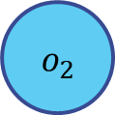






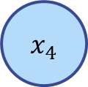

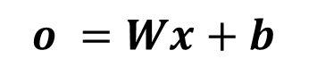
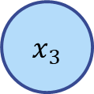
More complexity: adding a hidden layer
How do we make the model more complex?
The solution is quite simple: add one or more hidden layers and introduce non-linearities
$$o_{1}$$
$$o_{2}$$
$$o_{3}$$
$$o_{1}$$
$$o_{2}$$
$$o_{3}$$
X
X
Hidden Layer
$$h_{1}$$
$$h_{2}$$
$$h_{3}$$
$$h_{4}$$
$$h_{5}$$
$$x_{1}$$
$$x_{2}$$
$$x_{3}$$
$$x_{4}$$
X
$$o =Wx+b$$
$$x_{1}$$
$$x_{2}$$
$$x_{3}$$
$$x_{4}$$
$$h=W^{\left(1\right)}x+b^{\left(1\right)}$$
$$o=W^{\left(2\right)}h+b^{\left(2\right)}$$

Slide 17


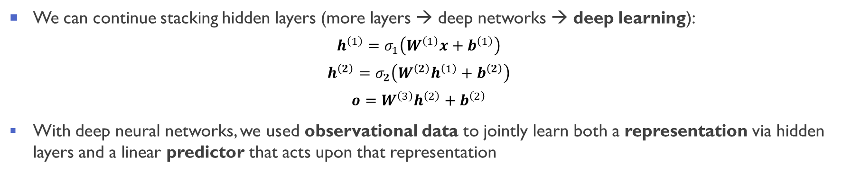
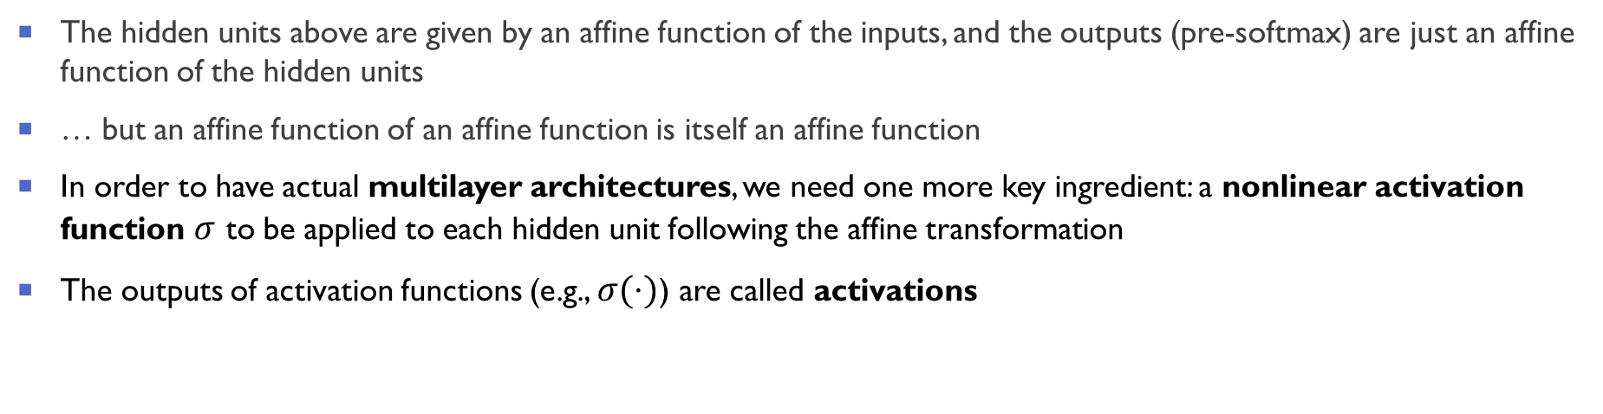


Going beyond linearity: finally a multilayer perceptron (MLP)
The hidden units above are given by an affine function of the inputs, and the outputs (pre-softmax) are just an affine function of the hidden units
… but an affine function of an affine function is itself an affine function
In order to have actual multilayer architectures, we need one more key ingredient: a nonlinear activation function $σ$ to be applied to each hidden unit following the affine transformation
The outputs of activation functions (e.g., $σ(⋅)$) are called activations
$$h=W^{\left(1\right)}x+b^{\left(1\right)}$$
$$h=σ(W^{\left(1\right)}x+b^{\left(1\right)})$$
$$o=W^{\left(2\right)}h+b^{\left(2\right)}$$
$$o=W^{\left(2\right)}h+b^{\left(2\right)}$$
We can continue stacking hidden layers (more layers → deep networks → deep learning):
$$h^{\left(1\right)}=σ_{1}\left(W^{\left(1\right)}x+b^{\left(1\right)}\right)$$
$$h^{\left(2\right)}=σ_{2}\left(W^{\left(2\right)}h^{\left(1\right)}+b^{\left(2\right)}\right)$$
$$o=W^{\left(3\right)}h^{\left(2\right)}+b^{\left(2\right)}$$
With deep neural networks, we used observational data to jointly learn both a representation via hidden layers and a linear predictor that acts upon that representation

Slide 18
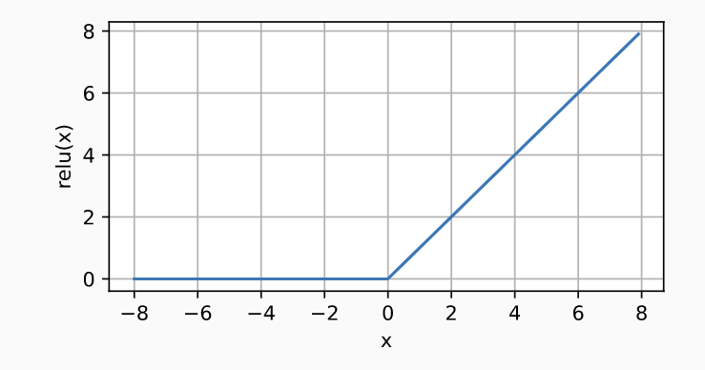
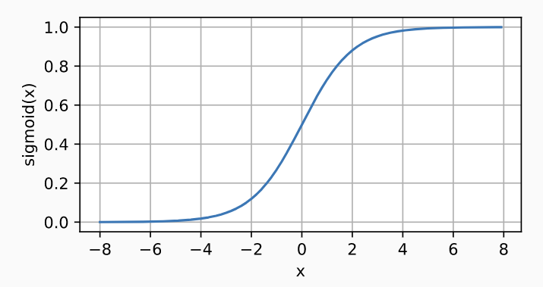
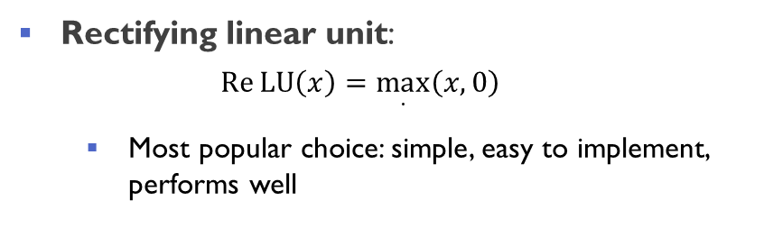
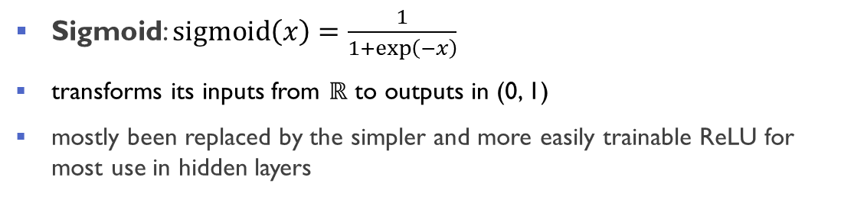
Activation functions
Activation functions decide whether a neuron should be activated or not by calculating the weighted sum and further adding bias with it
Rectifying linear unit:
$$\operatorname{Re}{\text{LU}\left(x\right)}=\max_{⋅}\left(x,0\right)$$
Most popular choice: simple, easy to implement, performs well
Sigmoid: $\operatorname{sigmoid}\left(x\right)=\frac{1}{1+\exp\left(−x\right)}$
transforms its inputs from $ℝ$ to outputs in (0, 1)
mostly been replaced by the simpler and more easily trainable ReLU for most use in hidden layers
Other choice are possible: leaky ReLU, exponential ReLU, parametrized ReLU, tanh

Slide 19
Neural networks as universal approximators
Neural networks with a single hidden layer can approximate any smooth function to any desired accuracy [1,2]
a single-hidden-layer network, given enough nodes (possibly absurdly many), and the right set of weights, can model any function
this does not say anything about how hard earning that function is!
To answer the question “how good neural networks are”:[3,4]
Expressibility: What class of functions can the neural network express?
Efficiency: How many resources (neurons, parameters etc) does the network require to approximate a given function?
Learnability: How rapidly can the network learn good parameters for approximating a function?
[1] Hornik et al., Neural Netw. 2, 359 (1989); [2] Cybenko et al., Math. Control Signals Syst. 2, 303 (1989)
[3] Lin et al., J. Stat. Phys. 168, 1223 (2017); [4] Rolnick et al., arXiv: 1705.05502, ICLR (2018)

Slide 20
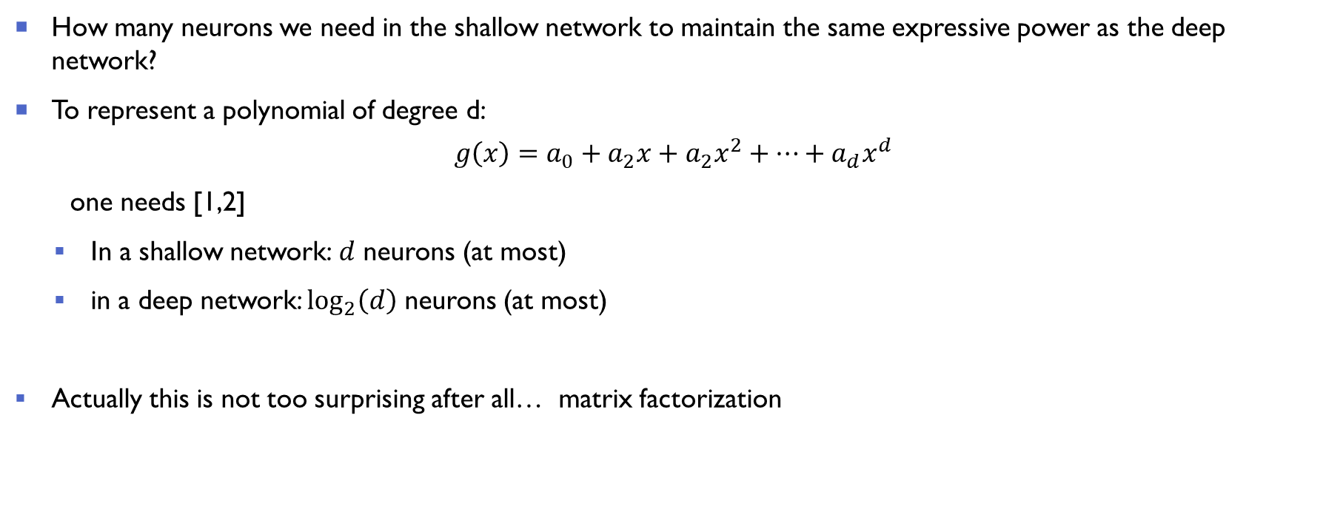
Shallow or deep networks?
How many neurons we need in the shallow network to maintain the same expressive power as the deep network?
To represent a polynomial of degree d:
$$g\left(x\right)=a_{0}+a_{2}x+a_{2}x^{2}+…+a_{d}x^{d}$$
one needs [1,2]
In a shallow network: $d$ neurons (at most)
in a deep network: $\log_{2}\left(d\right)$ neurons (at most)
Actually this is not too surprising after all… matrix factorization
[1] Lin et al., J. Stat. Phys. 168, 1223 (2017); [2] Rolnick et al., arXiv: 1705.05502, ICLR (2018)

Slide 21
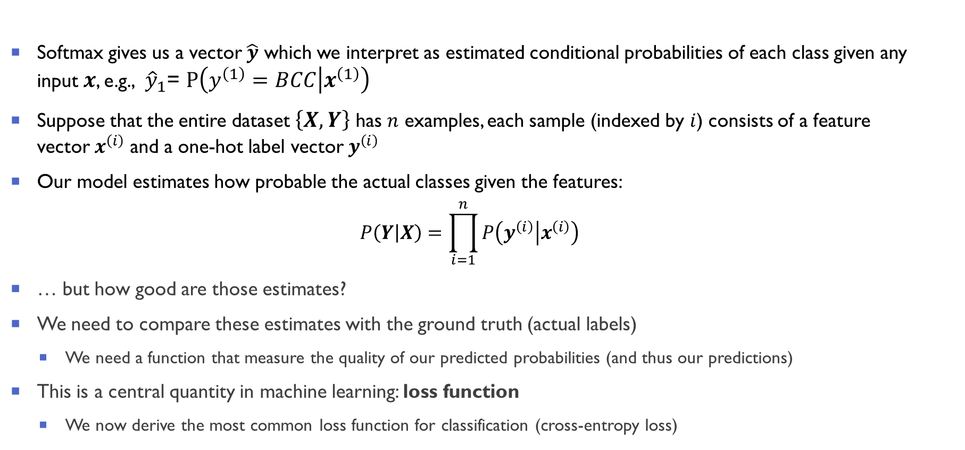
How do we measure the quality of our predictions?
Softmax gives us a vector $\hat{y}$ which we interpret as estimated conditional probabilities of each class given any input $x$, e.g., ${\hat{y}}_{1}$= $P\left(\left.y^{\left(1\right)}=BCC\right|x^{\left(1\right)}\right)$
Suppose that the entire dataset $\left\{X,Y\right\}$ has $n$ examples, each sample (indexed by $i$) consists of a feature vector $x^{\left(ⅈ\right)}$ and a one-hot label vector $y^{\left(ⅈ\right)}$
Our model estimates how probable the actual classes given the features:
$$P\left(\left.Y\right|X\right)=\prod_{i=1}^{n}{P\left(\left.y^{\left(i\right)}\right|x^{\left(i\right)}\right)}$$
… but how good are those estimates?
We need to compare these estimates with the ground truth (actual labels)
We need a function that measure the quality of our predicted probabilities (and thus our predictions)
This is a central quantity in machine learning: loss function
We now derive the most common loss function for classification (cross-entropy loss)
i.i.d

Slide 22







Slide 23





Slide 24

















Slide 25
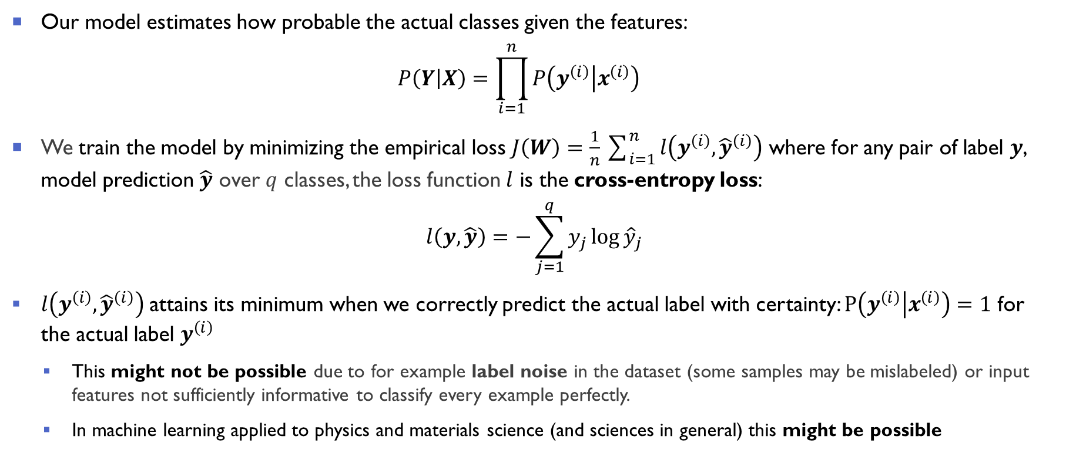
Cross-entropy loss
Our model estimates how probable the actual classes given the features:
$$P\left(\left.Y\right|X\right)=\prod_{i=1}^{n}{P\left(\left.y^{\left(i\right)}\right|x^{\left(i\right)}\right)}$$
We train the model by minimizing the empirical loss $J\left(W\right)=\frac{1}{n}\sum_{i=1}^{n}{l\left(y^{\left(ⅈ\right)},{\hat{y}}^{\left(ⅈ\right)}\right)}$ where for any pair of label $y$, model prediction $\hat{y}$ over $q$ classes, the loss function $l$ is the cross-entropy loss:
$$l\left(y,\hat{y}\right)=−\sum_{j=1}^{q}{y_{j}\log{{\hat{y}}_{j}}}$$
$l\left(y^{\left(ⅈ\right)},{\hat{y}}^{\left(ⅈ\right)}\right)$ attains its minimum when we correctly predict the actual label with certainty: $P\left(\left.y^{\left(ⅈ\right)}\right|x^{\left(ⅈ\right)}\right)=1$ for the actual label $y^{\left(ⅈ\right)}$
This might not be possible due to for example label noise in the dataset (some samples may be mislabeled) or input features not sufficiently informative to classify every example perfectly.
In machine learning applied to physics and materials science (and sciences in general) this might be possible

Slide 26
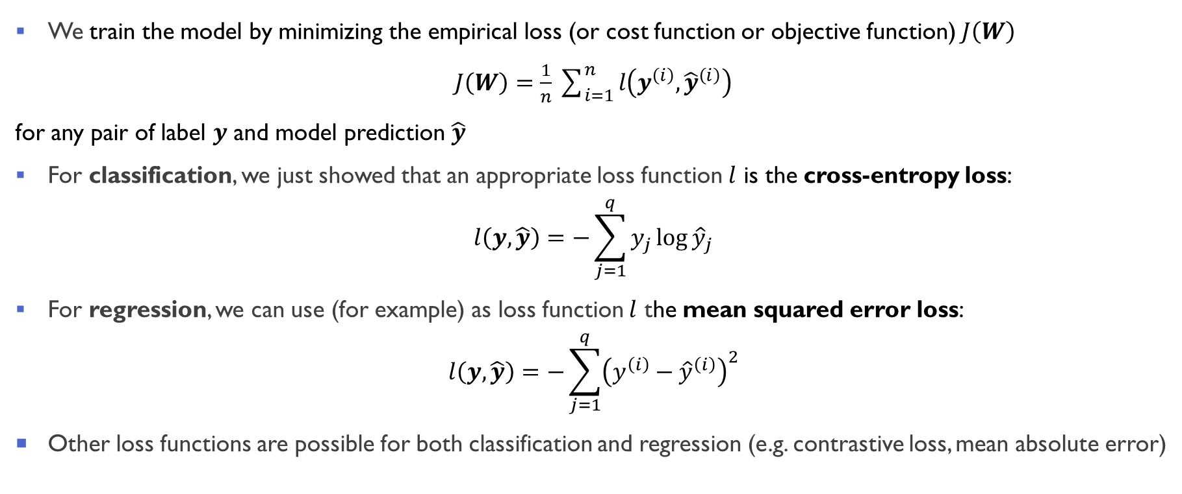
More generally: empirical loss for classification and regression
We train the model by minimizing the empirical loss (or cost function or objective function) $J\left(W\right)$
$J\left(W\right)=\frac{1}{n}\sum_{i=1}^{n}{l\left(y^{\left(ⅈ\right)},{\hat{y}}^{\left(ⅈ\right)}\right)}$
for any pair of label $y$ and model prediction $\hat{y}$
For classification, we just showed that an appropriate loss function $l$ is the cross-entropy loss:
$$l\left(y,\hat{y}\right)=−\sum_{j=1}^{q}{y_{j}\log{{\hat{y}}_{j}}}$$
For regression, we can use (for example) as loss function $l$ the mean squared error loss:
$$l\left(y,\hat{y}\right)=−\sum_{j=1}^{q}{{\left(y^{\left(ⅈ\right)}−{\hat{y}}^{\left(ⅈ\right)}\right)}^{2}}$$
Other loss functions are possible for both classification and regression (e.g. contrastive loss, mean absolute error)

Slide 27





















Notes:
Biases included in W

Slide 28
Lecture 1 Outline
Part 1.
Introduction to Neural Networks
1
Part 2.
Multi-layer perceptrons (MLPs)
2
Part 3.
Optimization and Regularization in Deep Learning
3
Part 4.
Convolutional Neural Networks (CNNs)
4

Slide 29
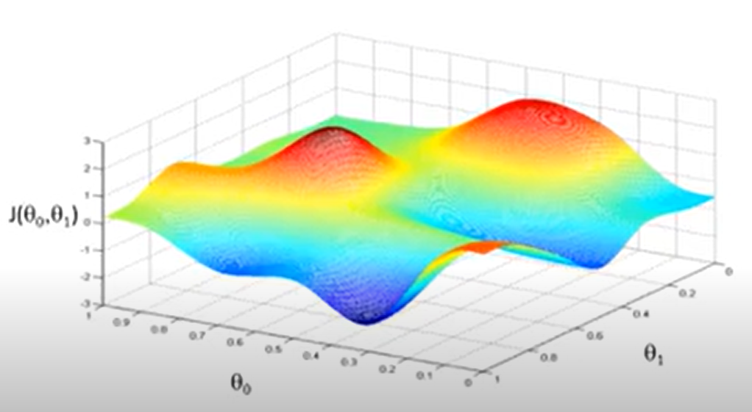

Neural network training: empirical loss optimization
Find the network weights that achieve the lowest empirical loss:
$$W^{∗}=\underset{w}{\text{arg}min}J\left(W\right)\text{= }\text{arg}\min_{w}\frac{1}{n}\sum_{i=1}^{n}{l\left(y^{\left(ⅈ\right)},{f(x}^{\left(ⅈ\right)};W)\right)}$$
where $W$ contains the weights at all layers $W=\left\{W^{\left(0\right)},W^{\left(1\right)},…\right\}$
We would like to do something like this…
Figure from Andrew Ng, Machine Learning, Coursera (https://www.coursera.org/learn/machine-learning)

Slide 30








Slide 31












Slide 32










Slide 33




Gradient Descent Algorithm
$f$ is our loss function $J\left(W\right)=\frac{1}{n}\sum_{i=1}^{n}{l\left(y^{\left(ⅈ\right)},{f(x}^{\left(ⅈ\right)};W)\right)}$
Gradient Descent Algorithm:
Initialize $W$ randomly (multiple strategies possible)
Loop until convergence:
Compute gradient $\frac{∂J\left(W\right)}{∂W}$
Update weights $W←W−η\frac{∂J\left(W\right)}{∂W}$
Return weights
The gradient $\frac{∂J\left(W\right)}{∂W}$ is very difficult to calculate
Depends on all weights at all layers (they can be millions!)
This is done via backpropagation

Slide 34

Computing gradients with backpropagation
How do we actually compute $\frac{∂J\left(W\right)}{∂W}$and how should we change the weights accordingly?
Backpropagation refers to the method of calculating the gradient $\frac{∂J\left(W\right)}{∂W}$ of neural network parameters
The method traverses the network in reverse order, from the output to the input layer, according to the chain rule of calculus
Chain rule of calculus:
Given functions $Y=f\left(X\right)$ and $Z=g\left(Y\right)$ we can compute the derivative of $Z$ with respect to $X$ via
$$\frac{∂Z}{∂X}=prod\left(\frac{∂Z}{∂Y},\frac{∂Y}{∂X}\right)$$
where $prod$ indicates the appropriate multiplication operator (for vectors is simply matrix multiplication)

Slide 35

















Slide 36








Slide 37




Slide 38

Notes:
Prod is now the elementwise multiplication

Slide 39

Notes:
Prod is now the elementwise multiplication

Slide 40





















Notes:
Prod is now the elementwise multiplication

Slide 41


Calculating the gradient with automatic differentiation
Automatic differentiation (autodiff): numerically evaluate the derivative of a function specified by a computer program.
exploits the fact that every computer program executes a sequence of elementary arithmetic operations (addition, subtraction, multiplication, division, etc.) and elementary functions (exp, log, sin, cos, etc.)
by applying the chain rule repeatedly to these operations, derivatives of arbitrary order can be computed automatically, accurately to working precision
Autodiff is better for derivates than
symbolic differentiation (e.g. Mathematica): inefficient code
numerical differentiation (the method of finite differences): errors due to discretization
All deep learning frameworks (e.g. PyTorch, TensorFlow) use autodiff
Used by most packages: Autograd (https://github.com/HIPS/autograd)
New and more versatile: JAX (https://github.com/google/jax)
Original program:
Sequence of primitive operations
$$t_{1}=wx$$
$$z=t_{1}+b$$
$$t_{3}=−z$$
$$t_{4}=\exp\left(−t_{3}\right)$$
$$t_{5}=1+t_{4}$$
$$y=1/t_{5}$$
$$t_{6}=y−t$$
$$t_{7}=t_{6}^{2}$$
$$J=t_{7}/2$$
$$z=Wx+b$$
$$y=\frac{1}{1+ⅇ^{−z}}$$
$$J=\frac{1}{2}{\left(y−t\right)}^{2}$$

Slide 42




Refresh: Gradient Descent Algorithm
Loss function $J\left(W\right)=\frac{1}{n}\sum_{i=1}^{n}{l\left(y^{\left(ⅈ\right)},{f(x}^{\left(ⅈ\right)};W)\right)}$
Gradient Descent Algorithm:
Initialize $W$ randomly
Loop until convergence:
Compute gradient $\frac{∂J\left(W\right)}{∂W}$
Update weights $W←W−η\frac{∂J\left(W\right)}{∂W}$
Return weights
The gradient $\frac{∂J\left(W\right)}{∂W}$ is calculated via backpropagation
The learning rate $η$is a crucial parameter

Slide 43






The importance of the learning rate $η$
$η$too small: converges slowly, might get stuck in non-optimal regions
$η$too large: overshoot, become unstable and diverges
$η$just right: goes smoothly to the desired solution
Figures from d2l.ai
How do we set the right learning rate?
It is very difficult (if not impossible) to find a good learning rate for the whole optimization
The solution is to use adaptive learning rates that adapt though the optimization

Slide 44

Adaptive Learning Rates
Adaptive learning rate: learning rate $η$ is no longer fixed, but it changes during optimization, depending on:
How large the gradient is
How stable has been the gradient in the last iterations
How fast the learning is happening
Size of weights
(Approximate) 2nd order information
Most commonly adaptive algorithms used:
Adam
Adadelta
Adagrad
RMSProp

Slide 45


Mini-batch gradient descent
Calculating the gradient $\frac{∂J\left(W\right)}{∂W}$over all samples is very expensive (typically millions)
Progress would be very slow
Mini-batch gradient descent: split the data in small batches and perform gradient descent for each batch
Introduces noise in the gradient estimate, but allow to make progress straight-away
Batch-size depends on memory on the GPU (e.g. $m=32,64,128$)
If $m=1$: stochastic gradient descent (too noisy to be used in practice)
If you have few samples (e.g. 2,000) perform gradient descent – especially relevant in physics/materials science
Mini-batch gradient descent algorithm:
Initialize $W$ randomly
Loop until convergence:
Pick mini-batch of $M$ data points
Compute gradient $\frac{∂J\left(W\right)}{∂W}=\frac{1}{M}\sum_{m=1}^{M}{\frac{∂J_{m}\left(W\right)}{∂W}}$
Update weights $W←W−η\frac{∂J\left(W\right)}{∂W}$
Return weights

Slide 46

Optimization or machine learning problem?
Given the loss $J\left(W\right)=\frac{1}{n}\sum_{i=1}^{n}{l\left(y^{\left(ⅈ\right)},{\hat{y}}^{\left(ⅈ\right)}\right)}=\frac{1}{n}\sum_{i=1}^{n}{l\left(y^{\left(ⅈ\right)},{f(x}^{\left(ⅈ\right)};W)\right)}$, it looks like the goal is to find the parameters that minimizes it:
$$W^{∗}=\underset{w}{\text{arg}min}J\left(W\right)\text{= }\text{arg}\min_{w}\frac{1}{n}\sum_{i=1}^{n}{l\left(y^{\left(ⅈ\right)},{f(x}^{\left(ⅈ\right)};W)\right)}$$
Optimization problems are solved all the time in physics (with much more complicated functional forms):
Ground state wavefunction of a quantum system:
$ψ^{GS}=\text{arg}\min_{ψ}\frac{\left\langle ψ\left|H_{ee}\right|y\right\rangle }{\left\langle \left.ψ\right|ψ\right\rangle }$ where $H_{ee}=T+V_{ee}+V_{ext}$
Ground state density (e.g. in density function theory):
$n^{GS}=\text{arg}\min_{n}E_{HK}\left[n\right]$ where $E_{HK}\left[n\right]=T\left[n\right]+V_{ee}\left[n\right]+V_{ext}\left[n\right]$
… but there we have never used regularization, or train/validation/test set and heuristics to solve these problems?
Why we need to deal with these techniques in machine learning?

Slide 47

How learning differs from pure optimization
The machine learning problem $W^{∗}=\underset{W}{\text{arg}min}J\left(W\right)$is not a pure (traditional) optimization problem
In machine learning, we care about some performance measure $A$, defined with respect to the test set (and may also be intractable)
$A$ is optimized only indirectly: we reduce a (different) cost function $J\left(W\right)$ hoping that doing so will improve $A$
This is in contrast to pure optimization, where minimizing J is the actual goal
Typically, the cost function can be written as an average over the training set, such as
$J\left(W\right)=\frac{1}{n}\sum_{i=1}^{n}{l\left({f(x}^{\left(ⅈ\right)};W),{\hat{y}}^{\left(ⅈ\right)}\right)}$= $𝔼_{\left(x,y\right)\sim {\hat{p}}_{data}}l\left(f\left(x,W\right);y\right)$
where ${\hat{p}}_{data}$ is the empirical distribution (what we observe through the training set!)

Slide 48

Expected generalization error
What we should actually minimize is the corresponding objective function where the expectation is taken across the true underlying data-generating distribution $p_{data}$ (rather than just over the finite training set):
$J^{∗}\left(W\right)=𝔼_{\left(x,y\right)\sim p_{data}}l\left(f\left(x,W\right),y\right)$ (1)
When we do not know $p_{data}$ (or it is too costly to compute) but only have a training set of samples, we have a machine learning problem
We thus optimize the empirical loss:
$J\left(W\right)=𝔼_{\left(x,y\right)\sim {\hat{p}}_{data}}l\left(f\left(x,W\right);y\right)$ = $\frac{1}{n}\sum_{i=1}^{n}{l\left({f(x}^{\left(ⅈ\right)};W),{\hat{y}}^{\left(ⅈ\right)}\right)}$ (2)
The goal of a machine learning algorithm is to reduce the expected generalization error given by equation (2)
Since we minimize (2) instead of (1), special techniques are needed (e.g. regularization, train/validation/test splits)

Slide 49








Slide 50


Underfitting, overfitting, and regularization
The central challenge in machine learning is that algorithms must perform well on new, previously unseen inputs
The ability to perform well on previously unobserved inputs is called generalization
Figure from d2l.ai
Deep neural networks are complex and flexible models: overfitting is the main problem (and not underfitting)
Regularization: collection of strategies to reduce model capacity in a “thoughtful way” to avoid overfitting
Notes:
Training and test error behave differently. Underfitting regime:
At the left end of the graph, training error and generalization error
are both high. As we increase capacity, training error
decreases, but the gap between training and generalization error increases. Eventually,
the size of this gap outweighs the decrease in training error, and we enter the overfitting
regime, where capacity is too large, above the optimal capacity.

Slide 51


Regularization
Definition of regularization [1]: “any modification we make to a learning algorithm that is intended to reduce its generalization error but not its training error.”
Multiple strategies possible:
Constraints and penalties designed to express a generic preference for a simpler models to promote generalization (e.g. $L^{2}$ and $L^{1}$ penalization)
Multiple hypothesis that explain the training data are combined in ensemble methods (e.g. dropout)
Stop the optimization early according to “external” metric such as validation set performance (e.g. early stopping)
Encode specific kinds of prior knowledge (e.g. special architectures like convolutional neural networks)
We will focus on the last three because they are specific of neural networks
[1] Deep Learning, Goodfellow, Bengio, and Courville, MIT Press (2016)

Slide 52

Dropout
Very general idea: inject noise into the training to promote simpler models
One useful notion of simplicity is smoothness (i.e. that the function should not be sensitive to small changes to its inputs)
Bishop [1] proved that training with input noise is equivalent to Tikhonov regularization: mathematical connection between the requirement that a function be smooth and the requirement that it be resilient to perturbations in the input
Dropout [2]: inject noise into each layer of the network by dropping out some neurons during training with (dropout) probability $p$:
each intermediate activation $h$ is replaced by a random variable $h^{′}$as follows:
$$h^{′}=\left\{\begin{aligned}0 with probability p \\ \frac{h}{1−p} otherwise\end{aligned}\right.$$
avoid overspecialization of the hidden units
[1] C. M. Bishop, Neural computation, 7(1), 108-116 (1995) [2] Srivastava et al. (2014), JMLR 15(1), 1929–1958 (2014)

Slide 53













Dropout in practice
Before dropout
Dropout (training step 1)
Dropout (training step 2)
$$o_{1}$$
$$o_{2}$$
$$o_{3}$$
$$o_{1}$$
$$o_{2}$$
$$o_{3}$$
$$o_{1}$$
$$o_{2}$$
$$o_{3}$$
X
X
X
$$h_{1}$$
$$h_{2}$$
$$h_{3}$$
$$h_{4}$$
$$h_{5}$$
$$h_{1}$$
$$h_{2}$$
$$h_{3}$$
$$h_{4}$$
$$h_{5}$$
$$h_{1}$$
$$h_{2}$$
$$h_{3}$$
$$h_{4}$$
$$h_{5}$$
X
X
X
$$x_{1}$$
$$x_{2}$$
$$x_{3}$$
$$x_{4}$$
$$x_{1}$$
$$x_{2}$$
$$x_{3}$$
$$x_{4}$$
$$x_{1}$$
$$x_{2}$$
$$x_{3}$$
$$x_{4}$$
In the example above: dropping $1/5$ hidden units: dropout probability $p=0.2$
Typical dropout values are between $p=0.1$ and $p=0.$5 depending on network and dataset size
In physics and materials science, you might need to use a small dropout if you have a small dataset/model

Slide 54
Dropout: additional considerations
Dropout trains the ensemble of all subnetworks that can be formed by removing nonoutput units from an underlying base network
The models share parameters, with each model inheriting a different subset of parameters from the parent neural network
Some additional considerations on dropout:
very computationally cheap
works well with nearly any model that uses a distributed representation (feedforward neural networks, recurrent, attention-based models)
when extremely few labeled training examples are available, dropout is less effective: Bayesian neural networks outperform dropout where fewer than 5,000 examples are available [1]
Dropout at test time is heuristic for estimating prediction uncertainty: if the predictions agree across many different dropout subnetworks → the network is more confident [2]
Base Network
Ensemble of subnetworks
[1] Deep Learning, Goodfellow, Bengio, and Courville, MIT Press (2016) [2] Y. Gal and Z. Ghahramani, ICML (2016), ArXiv:1506.02142
Notes:
The Lottery Ticket Hypothesis: A randomly-initialized, dense neural netw
[2] Frankle et al., AriXiv:1803.03635 (2018)ork contains a subnetwork that is initialized such that -when trained in isolation - it can match the test accuracy of the original network after training for at most the same number of iterations

Slide 55

Early stopping
When training large models with sufficient representational capacity to overfit the task, we often observe that training error decreases steadily over time, but validation set error begins to rise again
Early stopping: train until the generalization loss (e.g. validation error) increases and return the parameter setting at the point intime
has the effect of restricting the optimization procedure to a relatively small volume of parameter space in the neighborhood of the initial parameter values $W_{0}$
for a simple linear model with a quadratic error function and gradient descent, early stopping is equivalent to $L^{2}$ regularization [1]
may be used either alone or in conjunction with other regularization strategies
requires a validation set, which means some training data is not fed to the model
Figure from d2l.ai
[1] Deep Learning, Goodfellow, Bengio, and Courville, MIT Press (2016)

Slide 56
Deep Learning Regression: materials science example
In the tutorial by Andreas Leitherer an example of deep learning applied to a materials science problem
Goal of the example:
to predict the volume per atom for inorganic solids from the open quantum materials database (OQMD)
only information on the chemical composition is used (in particular, no structural information).
References:
D. Jha et al., Elemnet: Deep learning the chemistry of materials from only elemental composition. Scientific reports 8, 1 (2018).
D. Jha et al., Enhancing materials property prediction by leveraging computational and experimental data using deep transfer learning, Nature Communications, 10 (5316) (2019)
Now we discuss two recent advances where deep learning is used to solve the Schrödinger equation for small molecule with very high accuracy:
PauliNet: Hermann et al., Nat. Chem. 12, 891 (2020)
FermiNet: Pfau et al., Phys. Rev. Research 2, 033429 (2020)

Slide 57

The Schrödinger equation and its variational solution
Find a wavefunction $ψ\left(x_{1},x_{2},⋯x_{n}\right)$which is an eigenfunction of the Hamiltonian, $\hat{H}$of the system:
$$\hat{H}ψ\left(x_{1,⋯}x_{n}\right)=Eψ\left(x_{1},…,x_{n}\right)$$
$$\hat{H}=−\frac{1}{2}\sum_{i}{∇_{i}^{2}}+\sum_{i>j}{\frac{1}{\left|r_{i}−r_{j}\right|}+}\sum_{iI}{\frac{z_{I}}{\left|r_{i}−R_{I}\right|}}≡H_{ee}=T+V_{ee}+V_{ext}$$
where $E$ is the energy of the wavefunction $ψ$, $x_{i}=\left\{r_{i},σ_{i}\right\}$ are the coordinates of electron $i$ with $r_{i}$ position and $σ_{i}$ spin, $R_{I}$ and $Z_{I}$ are the position and atomic number of nucleus $I$
We can solve for the lowest-energy solution $E_{0}$via the variational principle
$$E_{0}=\min_{ψ}E\left[ψ\right]≤\min_{θ}E\left[ψ_{θ}\right]$$
by choosing a class of unnormalized wavefunctions parameterized by $θ$
$$\min_{θ}\frac{\left\langle ψ_{θ}\left|\hat{H}\right|ψ_{θ}\right\rangle }{\left\langle ψ_{θ}^{2}\right\rangle }=\min_{θ}\frac{\int{ⅆx_{1}}…{ x}_{n}ψ_{θ}\left(x_{1},…,x_{n}\right)\hat{H}ψ_{θ}\left(x_{1},…{,x}_{n}\right)}{\int{ⅆx_{1}}… dx_{n}ψ_{θ}^{2}\left(x_{1}… x_{n}\right)}$$
Notes:
(under the Born-Oppenheimer approximation, i.e. fixed nuclei)

Slide 58

Variational Quantum Monte Carlo Ansatz
$$\min_{θ}E\left[ψ_{θ}\right]=\min_{θ}\frac{\left\langle ψ_{θ}\left|\hat{H}\right|ψ_{θ}\right\rangle }{\left\langle ψ_{θ}^{2}\right\rangle }=\min_{θ}\frac{\int{ⅆx_{1}}…{ dx}_{n}ψ_{θ}\left(x_{1},…,x_{n}\right)\hat{H}ψ_{θ}\left(x_{1}…x_{n}\right)}{\int{ⅆx_{1}}… dx_{n}ψ_{θ}^{2}\left(x_{1}… x_{n}\right)}$$
We directly minimize the energy of a system via:
parametric approximation to the true wavefunction (wavefunction ansatz)
Monte Carlo sampling to evaluate the high-dimensional integral
optimize parameters in trial to reduce variational energy and improve trial wavefunction
This procedure is known as variational quantum Monte Carlo (VQMC) [1]
QMC calculations crucially depend on the quality of the trial-function: use best available physics-motivated trial[2]:
$$ψ\left(\left\{r_{i}\right\},θ\right)=ⅇ^{J\left(\left\{r_{i}\right\},b\right)}\sum_{n}{α_{n}φ_{n}\left(\left\{x_{i}\right\}\right)}$$
where each $x_{i}=(\left\{r_{i}\right\},c)$ results from the backflow transformation of the electronic coordinates $\left\{r_{i}\right\}$, each $φ_{n}$ is a multideterminant representation of a configuration state function CSF (e.g. single particle orbitals)
$θ=\left(a,b, c\right)$ are the variable wavefunction parameters: the CSF coefficients $a$, the Jastrow parameters $b$, and the backflow parameters $c$
[1] Foulkes et al., Rev. Mod. Phys., 73(1) 33 (2001) [2] Brown et al., J. Chem. Phys. 126, 224110 (2007)
Notes:
In a backflow wave function, the electron positions in the Slater determinant are replaced by “quasi-particle” coordinates that depend on the positions of other nearby electrons

Slide 59


Solving the Schrödinger equation with deep neural networks (1/2)
Artificial neural networks are being used as a wave function ansatz in VQMC frameworks for finding ground states of quantum mechanical systems.
Ref [1] used a VQMC objective function to train an artificial neural network to find the ground state of a many-body quantum state of N spins
Pauli Net [2] proposed the wavefunction ansatz
$ψ\left(r\right)=ⅇ^{γ\left(r\right)+J_{θ}\left(r\right)}\sum_{p}{c_{p}\det\left[{\tilde{φ}}_{θ,μ_{p}ⅈ}^{↑}\left(r\right)\right]\det\left[{\tilde{φ}}_{θ,μ_{p}ⅈ}^{↓}\left(r\right)\right]}$ ${\tilde{φ}}_{μⅈ}\left(r\right)=φ_{μ}$($r_{i}$) $f_{θ,μi}$($r$)
where both the Jastrow factor, $J,$and the backflow, $f$, are represented by deep neural networks (DNNs) with trainable parameters $θ$
The physics is encoded by the determinant form, the one-electron molecular orbitals, $φ_{μ}$ (via Hartree-Fock), and the electronic cusps, $γ$
Figure from [2]
[1] G. Carleo and M. Troyer, Science 355, 602 (2017) [2] Hermann et al., Nat. Chem. 12, 891 (2020) )[3] Pfau et al., Phys. Rev. Research 2, 033429 (2020)

Slide 60

Solving the Schrödinger equation with deep neural networks (2/2)
Fermi Net [3] uses the following neural network architecture as wavefunction ansatz:
Features of one or two electron positions are inputs to different streams of the network.
These features are transformed through several layers, a determinant is applied
The wave function at that position is given as output.
The (only) physics is the antisymmetric of the wavefunction via the determinant, the rest is learned
Figure taken from [1]
[1] Pfau et al., Phys. Rev. Research 2, 033429 (2020)

Slide 61

Solving an optimization problem (learning from equations)
Trained not from data, but from the variational principle (trained from equations) minimizing the total energy
$$\min_{θ}E\left[ψ_{θ}\right]=\min_{θ}\frac{\left\langle ψ_{θ}\left|\hat{H}\right|ψ_{θ}\right\rangle }{\left\langle ψ_{θ}^{2}\right\rangle }$$
For example, in PauliNet training data generated on-the-fly by sampling electron positions with a standard Langevin Monte Carlo approach using the current model wave function $ψ_{θ}$
It is a pure optimization problem: optimize $E\left[ψ_{θ}\right]$ via first-order (Adam) [1] or second-order [2] optimization methods
PauliNet[1] and FermiNet[2] wave functions are better than any other known type of VMC trial wave function used in such systems
Deep neural networks are very flexible functions
[1] Hermann et al., Nat. Chem. 12, 891 (2020)[2] Pfau et al., Phys. Rev. Research 2, 033429 (2020) [3] Spencer et al., NIPS 2020, arxiv:2011.07125
Notes:
We generate training data for PauliNet on-the-fly by sampling electron positions with a standard Langevin Monte Carlo approach (Umrigar et al., 1993) every 100 training iterations using the current model wave function 휓휽 .

Slide 62


PauliNet and FermiNet: Results
Both PauliNet[1] and FermiNet [2] achieve nearly 100% of the correlation energy for the system tested and to achieve accuracy beyond other variational quantum Monte Carlo Ansatz on a variety of atoms and small molecules (no solids)
For these systems, PauliNet recovers between 97% and 99.9% of the electron correlation energy after training for tens of minutes to few hours on a single GPU. From Ref [1]
Errors in the total energies of various molecules with up to 30 electrons calculated using Fermi Net, CCSD, and CCSD(T). From Ref [2]
[1] Hermann et al., Nat. Chem. 12, 891 (2020)[2] Pfau et al., Phys. Rev. Research 2, 033429 (2020)

Slide 63
Tutorials: multilayer perceptrons
We will use the (great) tutorials from Dive into Deep Learning (http://d2l.ai/)
Multilayer Perceptrons from scratch: 4.2. Implementation of Multilayer Perceptrons from Scratch — Dive into Deep Learning 0.17.0 documentation (d2l.ai)
Link: http://d2l.ai/chapter_multilayer-perceptrons/mlp-scratch.html
PyTorch implementation: mlp-scratch.ipynb - Colaboratory (google.com)
Multilayer Perceptrons (concise implementation): 4.3. Concise Implementation of Multilayer Perceptrons — Dive into Deep Learning 0.17.0 documentation (d2l.ai)
Link: http://d2l.ai/chapter_multilayer-perceptrons/mlp-concise.html
PyTorch implementation: mlp-concise.ipynb - Colaboratory (google.com))
[Optional] Multilayer perceptrons: predicting formation energies (NOMAD laboratory)
Link: https://nomad-lab.eu/prod/analytics/public/user/6cb97a6b-e14a-4559-ad0f-a3dde4a904ac/notebooks/tutorials/nn_regression.ipynb

Slide 64

Multilayer perceptrons from scratch
Multilayer Perceptrons from scratch: 4.2. Implementation of Multilayer Perceptrons from Scratch — Dive into Deep Learning 0.17.0 documentation (d2l.ai)
Link: http://d2l.ai/chapter_multilayer-perceptrons/mlp-scratch.html
PyTorch implementation: mlp-scratch.ipynb - Colaboratory (google.com)
Fashion-MNIST is a database of Zalando’s article images
Drop-in replacement for MNIST
60,000 training images and 10,000 testing images
Each example is a 28x28 grayscale image, associated with a label from 10 classes
Labels: 10 classes (trousers, pullover, dress, coat, sandal…)
Figure from zalandoresearch/fashion-mnist (github.com)
[MNIST] LeCun et al., (1998), Proceedings of the IEEE, 86(11), 2278–2324 (1998)
[FashionMNIST] Xiao et al., arXiv:1708.07747 (2017); data available here: Fashion MNIST | Kaggle

Slide 66

Multilayer perceptrons (concise implementation)
Multilayer Perceptrons (concise implementation): 4.3. Concise Implementation of Multilayer Perceptrons — Dive into Deep Learning 0.17.0 documentation (d2l.ai)
Link: http://d2l.ai/chapter_multilayer-perceptrons/mlp-concise.html
PyTorch implementation: mlp-concise.ipynb - Colaboratory (google.com))
The goal is exactly the same as “Multilayer perceptrons from scratch” but now we use state-of-the-art codes for neural network modelling (PyTorch)
PyTorch

